Slide 1
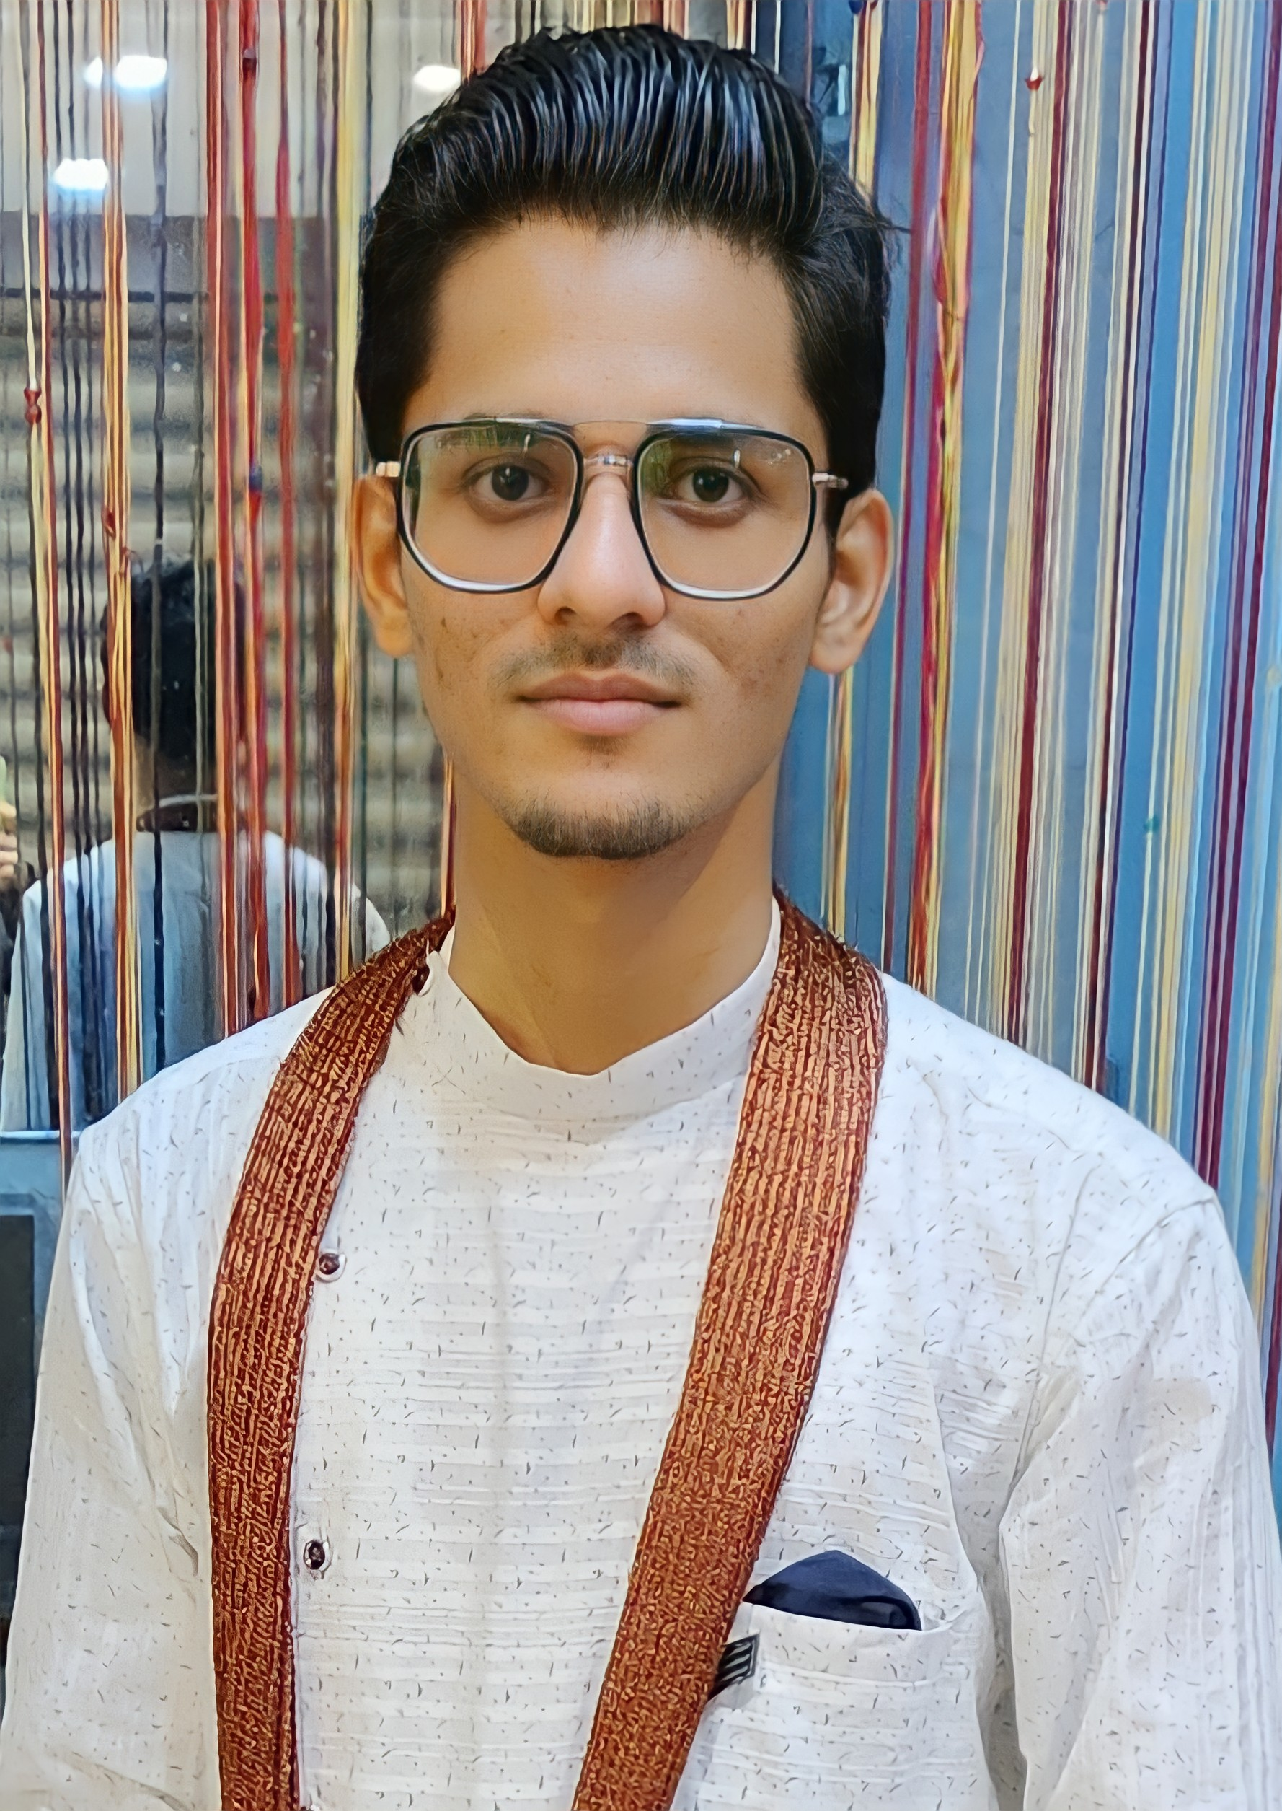
Creative Works
Creative Works
Developer
&
Coder
Somnath Kaushik
Web Developer / Coder
Hello! I’m Somnath Kaushik from Mathura, UP, India, and I’m pursuing a B.Tech in Computer Science and Engineering at GLA University, graduating in 2025.
As a passionate web developer, I excel in HTML, CSS, Tailwind, JavaScript, Node.js, Express.js, React, Vite, MongoDB, Kotlin, XML, and Java. My practical experience includes a 3-month internship at Assert Infotech, Jaipur, and a 2-month internship at Fusiotech, where I developed dynamic, responsive web applications.
I have solved over 350 questions on Leetcode, demonstrating my problem-solving skills and coding expertise. I’m deeply passionate about development and entrepreneurship, always eager to learn and innovate.
I am confident that my technical skills, hands-on experience, and passion make me a perfect fit for high-impact roles in your esteemed organization. I look forward to the opportunity to contribute to your team and drive technological excellence.

